Slide 1
Jesus the man who changed lives
Lesson 2

Slide 2
Change. What did we decide that it meant last week?

Slide 3
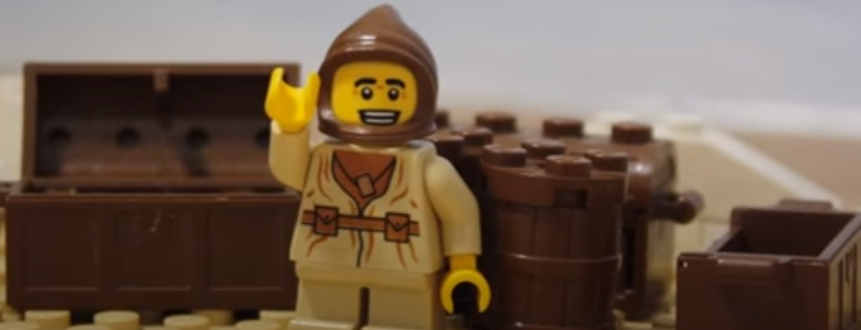
This week we are going to be looking at the story of Zacchaeus and how his life changed when he met Jesus.

Slide 4
Watch this video to hear a modern version of the story
https://www.youtube.com/watch?v=DdOSWhqQwhw

Slide 5
(Jesus and Zacchaeus were not really lego people, they have been shown this way to help you understand the story!)

Slide 6

Now listen to this version of the story from the Lions Story Teller Bible

Slide 7
In class we are going to act this story out. Could you do that at home? Or maybe act it out with some lego or other toys?

Slide 8
If you met Zacchaeus what would you ask him? Think of some questions.

Slide 9
Draw a heart big enough to fill your paper (or print one out). - On the first side write as many adjectives (describing words) as you can to describe Zacchaeus before he met Jesus, think about his size, what he is like, and how he treat people and cheated them by taking too much tax (money).

Slide 10
On the other side write words which describe Zacchaeus after he met Jesus.

Slide 11
Put a photo of your work on seesaw so we can see what ideas you have come up with.

