Slide 1


Slide 2
DATE:
L.O: to multiply a 2 digit number by a 1 digit number and exchange

Slide 3
Lets practise saying our 4 x tables.
Now lets try our 8s.

Slide 4
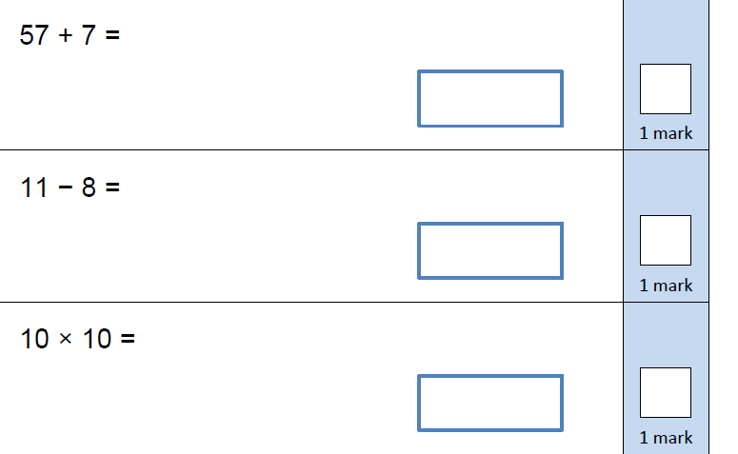
Try these on your whiteboards:
Try these on your whiteboards:
Try these on your whiteboards:

Slide 6
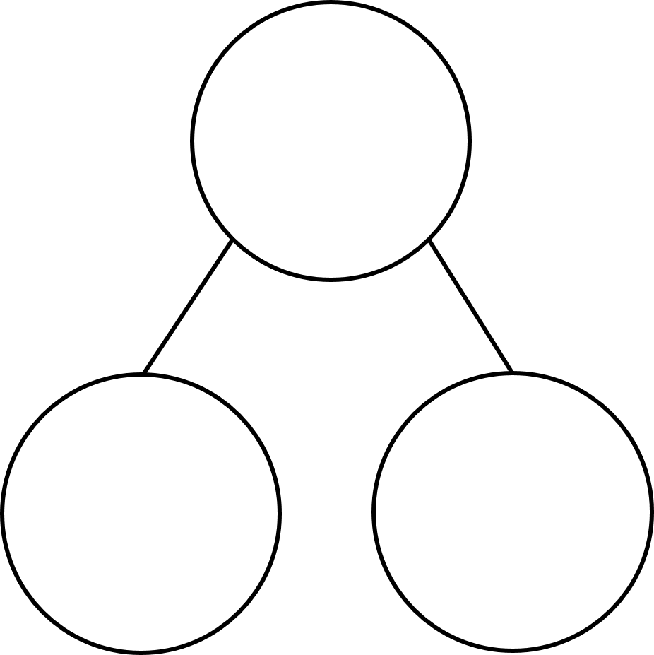

Complete the calculations
1)
3 $×$ 6 $=$ 3 $×$ 60 $=$
2) 5 $×$ 4 $=$ 5 $×$ 40 $=$
6 $×$ 4 $=$ 6 $×$ 40 $=$
3) Complete the part-whole models
30
27

Slide 7
Complete the calculations
1)
3 $×$ 6 $=$ 3 $×$ 60 $=$
2) 5 $×$ 4 $=$ 5 $×$ 40 $=$
6 $×$ 4 $=$ 6 $×$ 40 $=$
3) Complete the part-whole models
18
180
20
200
24
240
34
30
27
57

Slide 9

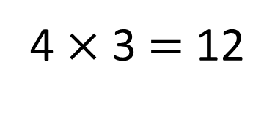
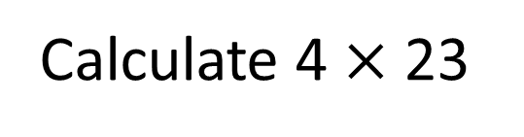
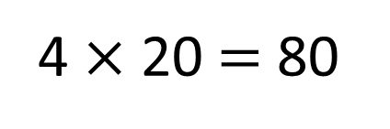
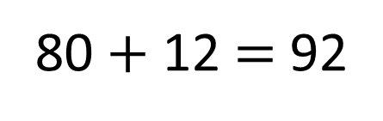
Calculate 4 $×$ 23
4 $×$ 20 $=$ 80
4 $×$ 3 $=$ 12
80 $+$ 12 $=$ 92

Slide 10

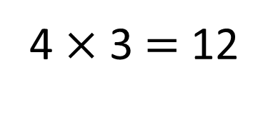
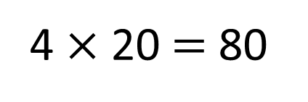
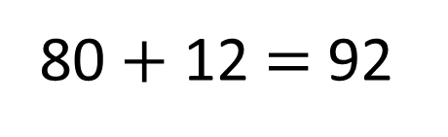
Calculate 4 $×$ 23
23
20
3
4 $×$ 20 $=$ 80
4 $×$ 3 $=$ 12
80 $+$ 12 $=$ 92

Slide 11

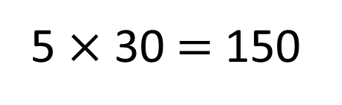
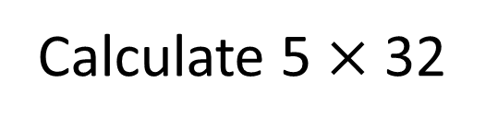
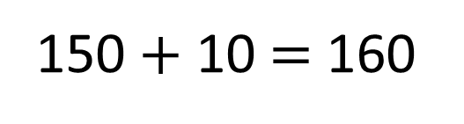
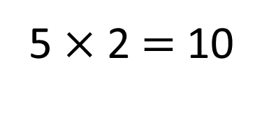
Calculate 5 $×$ 32
Have a think
32
30
2
5 $×$ 30 $=$ 150
5 $×$ 2 $=$ 10
150 $+$ 10 $=$ 160

Slide 12
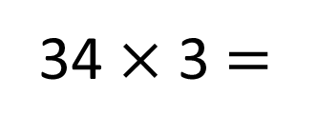
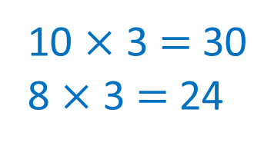
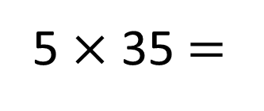
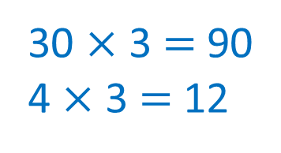
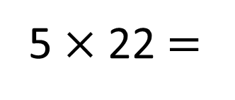
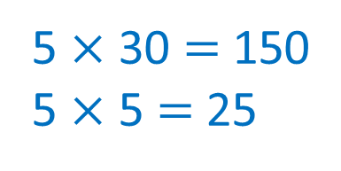
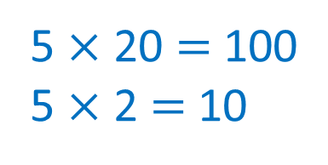
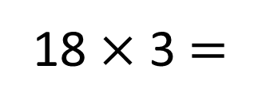
Calculate
Have a think
5 $×$ 22 $=$
110
5 $×$ 35 $=$
175
5 $×$ 20 $=$ 100
5 $×$ 2 $=$ 10
5 $×$ 30 $=$ 150
5 $×$ 5 $=$ 25
34 $×$ 3 $=$
102
18 $×$ 3 $=$
54
30 $×$ 3 $=$ 90
4 $×$ 3 $=$ 12
10 $×$ 3 $=$ 30
8 $×$ 3 $=$ 24

Slide 13


Arrange the digit cards into the calculation below.
3
4
5
Have a think
$$×$$
How many different totals can you make?
What is the greatest total you can make?
What is the smallest?
What do you notice? Does this always happen?

Slide 14
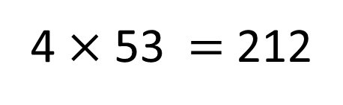
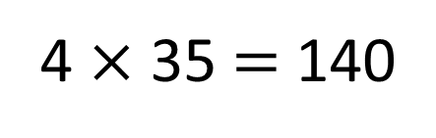

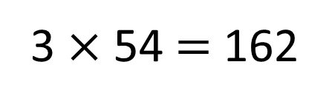
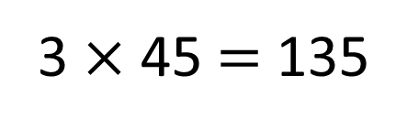
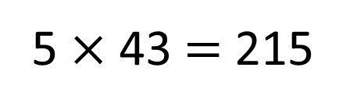
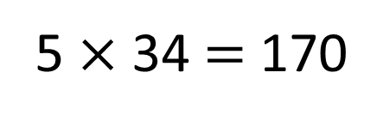
Arrange the digit cards into the calculation below.
3
4
5
$$×$$
3 $×$ 45 $=$ 135
4 $×$ 35 $=$ 140
5 $×$ 34 $=$ 170
3 $×$ 54 $=$ 162
4 $×$ 53 $=$ 212
5 $×$ 43 $=$ 215
6
How many different totals can you make?

Slide 15
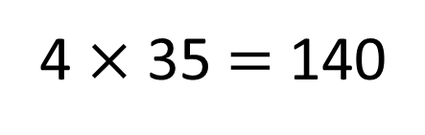
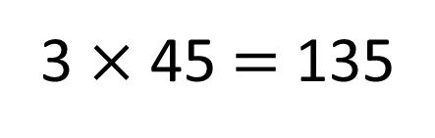
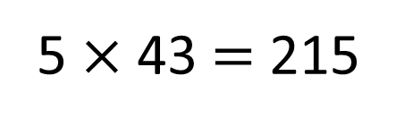
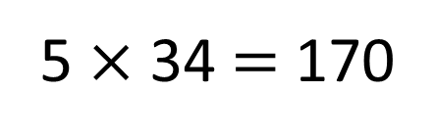
3
4
5
5
4
3
Placing the cards in ascending order gives the smallest possible total.
3 $×$ 45 $=$ 135
4 $×$ 35 $=$ 140
5 $×$ 34 $=$ 170
Placing the cards in descending order gives the greatest possible total.
3 $×$ 54 $=$ 162
4 $×$ 53 $=$ 212
5 $×$ 43 $=$ 215
215
What is the greatest total you can make?
What is the smallest?
What do you notice? Does this always happen?
135

Slide 16

What if you used these cards?
2
6
4
Have a think
$$×$$
How many different totals can you make?
What is the greatest possible total?
What is the smallest?

Slide 17

Use 3 digit cards to complete the calculation below.
$× =$72
Have a think
Which 3 cards could you use?
Can you find more than one solution?

Slide 18
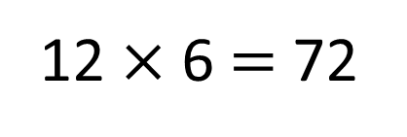
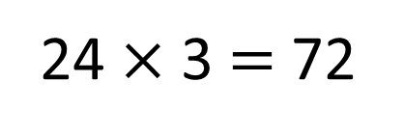
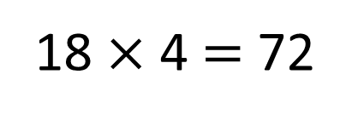
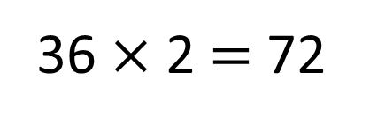

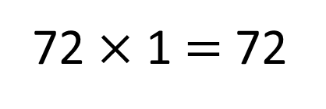
Use 3 digit cards to complete the calculation below.
$× =$72
72 $×$ 1 $=$ 72
36 $×$ 2 $=$ 72
12 $×$ 6 $=$ 72
24 $×$ 3 $=$ 72
18 $×$ 4 $=$ 72

Slide 19
DATE:
L.O: to multiply a 2 digit number by a 1 digit number and exchange

