Slide 1









Premier League Champions

Slide 2


Premier League Champions
Can you complete each season securing enough points to get promoted from the National League all the way to being a Premier League Champion?
10 challenges per season (PE/English/Maths/PSHE)
Points are secured by reaching a certain level on each challenge
Tally your points over the season to see if you get promoted
Minimal equipment is needed, if you don’t have the required equipment can you use something from around the house e.g. socks instead of a tennis ball
Take pictures/videos completing the challenges and send to jack.mountain@pne.com to be entered into the prize draw

Slide 3

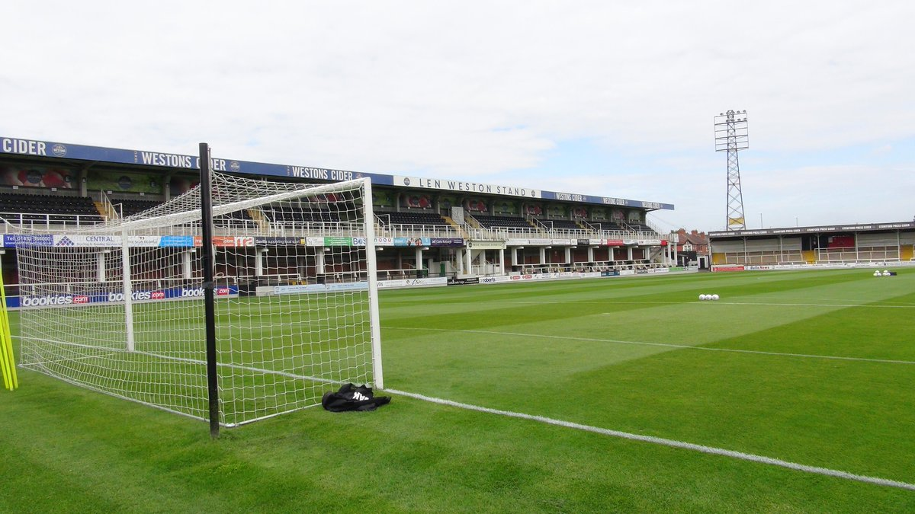
Season 1
Complete all 10 fixtures in the season
After the 10th fixture add up your points
20 points needed for promotion

Slide 4

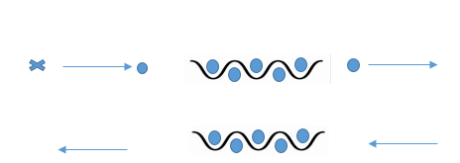

Football: Dribbling: KS2
Game 1
Curriculum links
Simple ball control
Challenge
Dribble through the cones, without touching them
Coaching points
Small touches of the ball
Keep ball close control
Use different parts of the foot- sole, inside, outside and laces
3 Points: If you don’t touch any of the cones
2 Points: If you touch 2 cones
1 Point: If you touch 3 or more cones

Slide 5
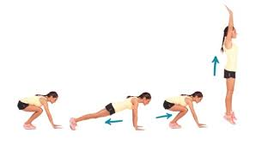
Gymnastics: Burpee Challenge: KS2
Game 2
Curriculum links
Develop strength and co-ordination
Challenge
How many Burpees can you do in 30 seconds?
Coaching points
Bottom to heels each time you crouch down
Arms by the ears when jumping up in the air
Body should be in a front support shape when down on the floor
Keep feet together
3 Points: 15 or more
2 Points: 9-14
1 Point: 1-8

Slide 6

Rugby: air passes: KS2
Game 3
Curriculum links
Throwing and catching in isolation
Develop flexibility, strength, technique, control and balance
Challenge
Players will throw the ball in the air as many times as they can in a minute.
Ball must go above head height.
If no rugby ball is available, player can use any ball, or balls of socks.
Coaching points
Fingertips on ball, palms not touching ball.
Eyes always on ball, hands up ready to catch it.
Ball to go over head height.
Quick throws.
3 Points: 25+ throws in a minute
2 Points: 15 throws in a minute
1 Point: 5 throws in a minute

Slide 7

English: Reading: KS2
Game 4
Curriculum links
Read easily, fluently and with good understanding
Use discussion in order to learn; you should be able to elaborate and explain clearly your understanding
Challenge
Pick a book that you have at home and start reading
Points are scored for how much you read in one sitting
After you’ve finished reading can you speak to an adult about what happened in the chapters read.
3 Points: 5+ Chapters
2 Points: 3-4 Chapters
1 Point: 1-2 Chapters

Slide 8
FMS: Figure of 8- KS2
Game 5
Curriculum links
develop flexibility, strength, technique, control and balance
take part in outdoor and adventurous activity challenges both individually and within a team
Challenge
Players will put the ball through one leg, then through the other one, which counts as one.
Feet must stay on the floor.
Use any ball or any household item.
Coaching points:
Finger tips on ball, not palms.
Use both hands and move around the body.
Feet stay on the floor.
3 Points: 20+
2 Points : 10
1 Points : 5

Slide 9
Maths: Numbers Game: KS2
Game 6
Curriculum links
Solve problems by applying mathematics to a variety of routine and non-routine problems
Including breaking down problems into a series of simpler steps and persevering in seeking solutions
Challenge
Follow the link http://happysoft.org.uk/countdown/numgame.php
Select the numbers and once the number has been generated try and solve the problem
Use a pen and paper to do your working out
If you need to use a calculator to help you
3 Points: Get the answer correct in 0-5 minutes
2 Points : Get the answer correct in 5-7 minutes
1 Points : Get the answer correct

Slide 10
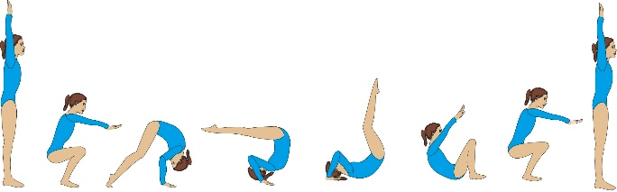
Gymnastics: Roll Challenge: KS2
Game 7
Curriculum links
Develop flexibility, strength, technique, control and balance
Challenge
Coaching points
Egg Roll- Knees tucked into chest
Teddy Bear Roll- Keep the Straddle shape, legs straight, roll over shoulders
Forward Roll- Head tucked in, back of head touches the floor
Try not to use your hands to help you up at the end. Roll from two feet.
3 Points: Can you perform a Forward Roll, without using your hands to help you up?
2 Points: Can you perform a Teddy Bear Roll?
1 Point: Can you perform a Egg Roll?

Slide 11
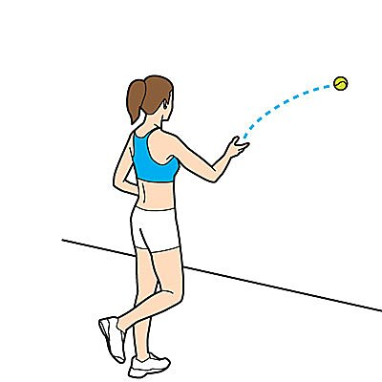
FMS: Target throwing – KS2
Game 8
Curriculum links
Master basic movements including throwing and catching
Challenge
Find objects that can act as targets.
Place your first target 1 step away from you, second target 2 steps away from you, third target 3 steps away from you etc.
The objective is to throw a ball onto the targets to get as many points as possible in 1 minute.
Coaching points
Under arm throw: take a step forwards with your right foot (if you are left handed) and left foot (if you are right handed).
Ball starts in one hand down by your hip, gently move your arm back and let go of the ball when it gets passed your hip again.
3 Points: 11+ targets
2 Points: 6-10 targets
1 Point: 0-5 targets

Slide 12
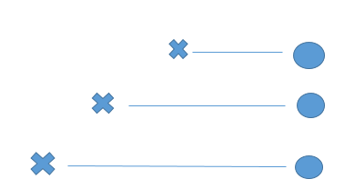
Football: Half Volleys: KS2
Game 9
Curriculum links
Develop kicking technique
Improve balancing skills
Challenge
Kick a football after a bounce into a bin, basket or a box
Coaching points
Use different parts of the foot- Laces or inside of the foot
1 Point: 5 metres
2 Points: 10 metres
3 Points: 15 metres

Slide 13
FMS: Throwing and Catching: KS2
Game 10
Curriculum links
Master basic movements including throwing and catching
Challenge
Find a wall and throw a ball against the wall using a underarm throw.
See how many catches you can do in a row when it comes back off the wall (without dropping it).
When you drop the ball, it goes back to zero.
Coaching points
Start in the set position: feet slightly wider that should width a part and slightly bending your knees
Under arm throw: ball starts in one hand down by your hip, gently move your arm back and let go of the ball when it gets passed your hip again
Catching: Use the cup shape with fingers and hands together.
3 Points: 11+ catches
2 Points: 6-10 catches
1 Point: 0-5 catches

Slide 14
End of the season
Game | Points Scored | Total Points
1
2
3
4
5
6
7
8
9
10
20+ points needed for promotion to League 2
If you don’t have enough points for promotion, re do any game where you don’t have full points.
Send your results, pictures and videos to jack.mountain@pne.com to be entered into a prize draw

